Slide 1
Linear Search Algorithm (Sequential Search Algorithm) in Data Structure

Slide 2
Search: Search is a process of finding a value in a list of values. In other words, searching is the process of locating given value position in a list of values.
Linear search:
Linear search is a very simple search algorithm. In this type of search, a sequential search is made over all items one by one.
Every item is checked and if a match is found then that particular item is returned, otherwise the search continues till the end of the data collection.
Linear search algorithm finds a given element in a list of elements with O(n) time complexity where n is total number of elements in the list.

Slide 3
This search process starts comparing search element with the first element in the list. If both are matched then result is element found otherwise search element is compared with next element in the list. Repeat the same until search element is compared with last element in the list, if that last element also doesn't match, then the result is "Element not found in the list". That means, the search element is compared with element by element in the list.

Slide 4
Step by Step Process
Algorithm
Step 1 - Read the search element from the user.
Step 2 - Compare the search element with the first element in the list.
Step 3 - If both are matched, then display "Given element is found!!!" and terminate the function
Step 4 - If both are not matched, then compare search element with the next element in the list.
Step 5 - Repeat steps 3 and 4 until search element is compared with last element in the list.
Step 6 - If last element in the list also doesn't match, then display "Element is not found!!!" and terminate the function.

Slide 5
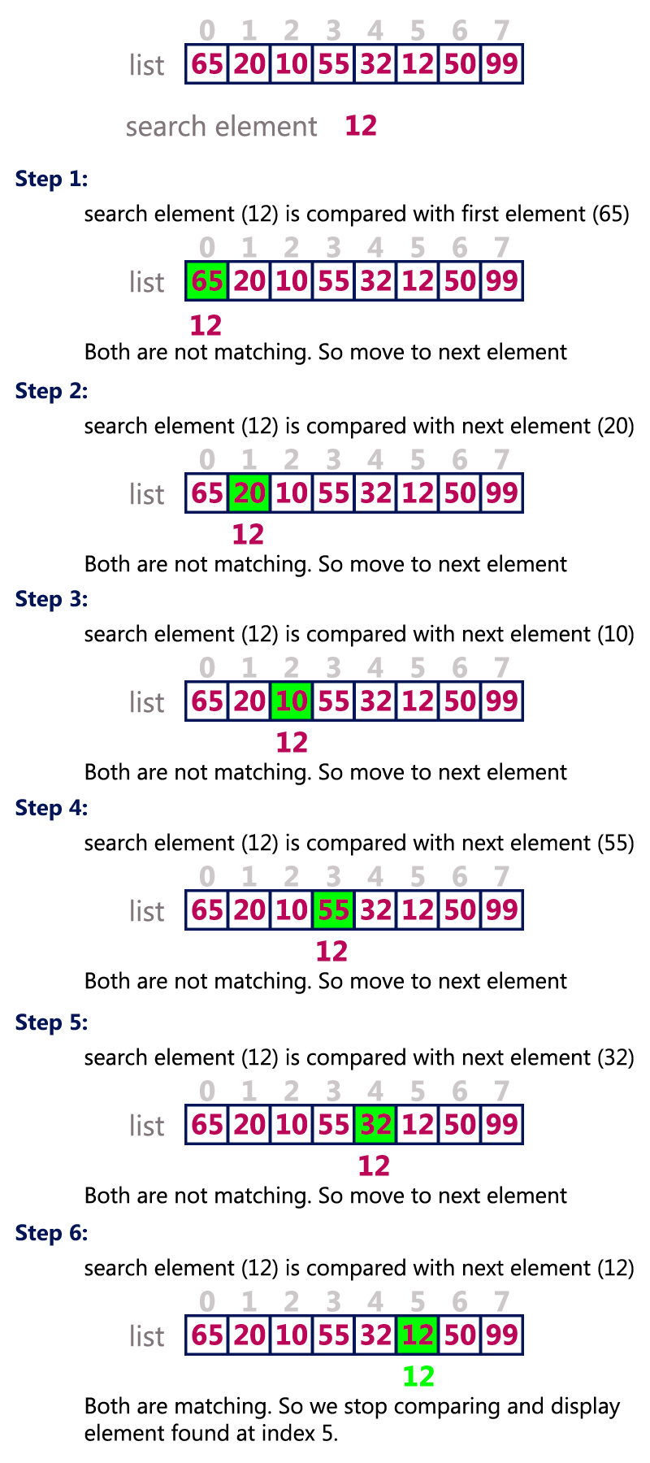
Example:

Slide 7
Linear/Sequential Searching Implementation

Slide 8
#include<stdio.h>
#include<conio.h>
void main()
{
int list[20],size,i,El;
printf("Enter size of the list: ");
scanf("%d",&size);
printf("Enter any %d integer values: ",size);
for(i = 0; i < size; i++)
scanf("%d",&list[i]);
printf("Enter the element to be Search: ");
scanf("%d",&El);
// Linear Search Logic
for(i = 0; i < size; i++)
{

Slide 9
if(El == list[i])
{
printf("Element is found at %d index", i);
break;
} }
if(i == size)
printf("Given element is not found in the list!!!");
getch();
}

Slide 10
/* Simple Linear Search Program Using Functions in Data Structure Programs*/
#include<stdio.h>
#include<conio.h>
#define MAX_SIZE 5
void linear_search(int[], int);
int main()
{
int arr_search[MAX_SIZE], i, element;
printf("\nEnter %d Elements for Searching : \n", MAX_SIZE);
for (i = 0; i < MAX_SIZE; i++)
scanf("%d", &arr_search[i]);
printf("Enter Element to Search : ");
scanf("%d", &element);

Slide 11
//Linear Search Function
linear_search(arr_search, element);
getch();
}
void linear_search(int fn_arr[], int element)
{
int i;
/* for : Check elements one by one - Linear */
for (i = 0; i < MAX_SIZE; i++)
{
if (fn_arr[i] == element)
{
printf("Linear Search : %d is Found at array : %d.\n", element, i + 1);
break;
} }

Slide 12
if (i == MAX_SIZE)
printf("\n Search Element : %d : Not Found \n", element);
}

Slide 13
Binary Search

Slide 14
Binary search is a fast search algorithm with run-time complexity of Ο(log n). This search algorithm works on the principle of divide and conquer. For this algorithm to work properly, the data collection should be in the sorted form.
Binary search looks for a particular item by comparing the middle most item of the collection. If a match occurs, then the index of item is returned. If the middle item is greater than the item, then the item is searched in the sub-array to the left of the middle item. Otherwise, the item is searched for in the sub-array to the right of the middle item. This process continues on the sub-array as well until the size of the subarray reduces to zero.

Slide 15
Pseudocode
Procedure binary_search
A ← sorted array
n ← size of array
x ← value to be searched
Set lowerBound = 1
Set upperBound = n
while x not found
if upperBound < lowerBound
EXIT: x does not exists.
set midPoint = lowerBound + ( upperBound - lowerBound ) / 2
if A[midPoint] < x
set lowerBound = midPoint + 1
if A[midPoint] > x
set upperBound = midPoint - 1
if A[midPoint] = x
EXIT: x found at location midPoint
end while
end procedure

Slide 16
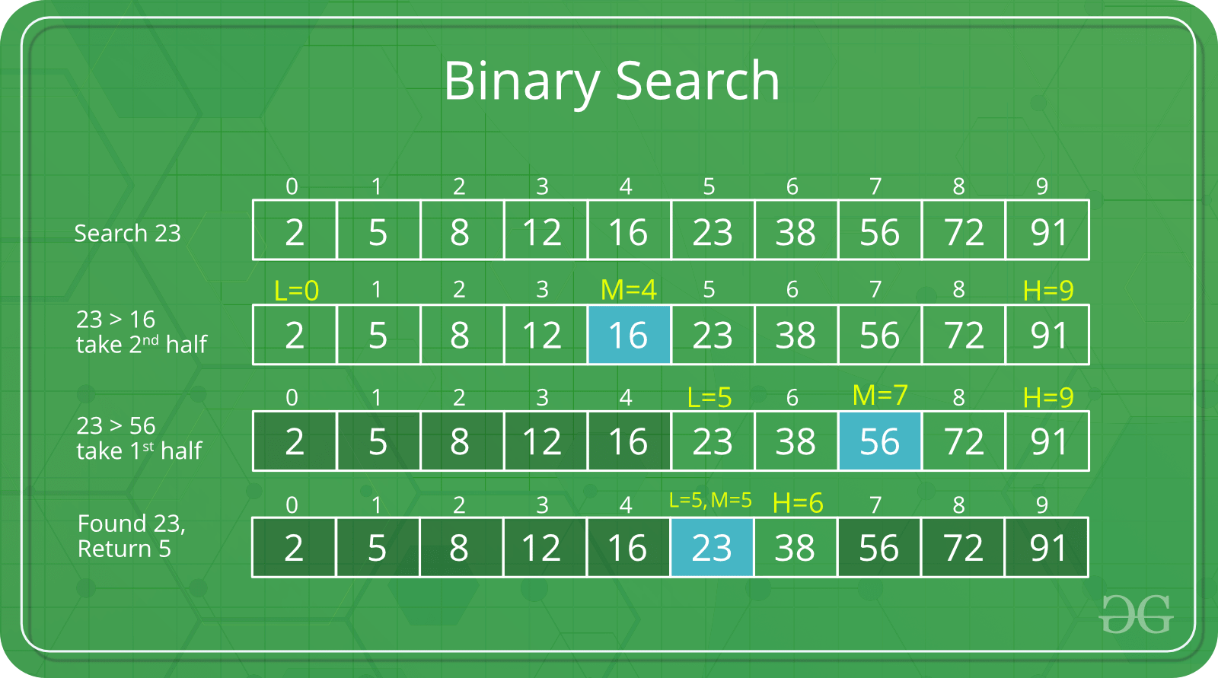
Example:

Slide 17

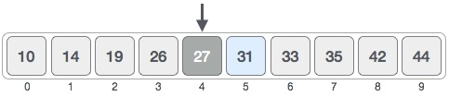
Example of Binary Search:
The following is our sorted array and let us assume that we need to search the location of value 31 using binary search.
First, we shall determine half of the array by using this formula −
mid = low + (high - low) / 2
Here it is, 0 + (9 - 0 ) / 2 = 4 (integer value of 4.5). So, 4 is the mid of the array.

Slide 18

Now we compare the value stored at location 4, with the value being searched, i.e. 31. We find that the value at location 4 is 27, which is not a match. As the value is greater than 27 and we have a sorted array, so we also know that the target value must be in the upper portion of the array.
We change our low to mid + 1 and find the new mid value again.
low = mid + 1
mid = low + (high - low) / 2
Our new mid is 7 now. We compare the value stored at location 7 with our target value 31.

Slide 19
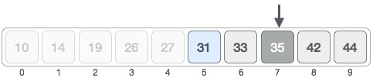

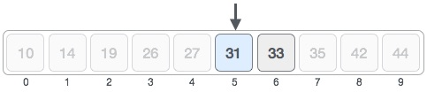
The value stored at location 7 is not a match, rather it is more than what we are looking for. So, the value must be in the lower part from this location.
Hence, we calculate the mid again. This time it is 5.

Slide 20

We compare the value stored at location 5 with our target value.
We find that it is a match.
We conclude that the target value 31 is stored at location 5.
Binary search halves the searchable items and thus reduces
the count of comparisons to be made to very less numbers.

Slide 21
/* Binary Search Program Using Functions*/
#include<stdio.h>
#include<conio.h>
#define MAX_SIZE 5
void binary_search(int[],int);
int main()
{
int arr_search[MAX_SIZE], i,element;
printf("\n Enter %d Elements for Searching : \n", MAX_SIZE);
for (i = 0; i < MAX_SIZE; i++)
scanf("%d", &arr_search[i]);
printf("Enter Element to Search : ");
scanf("%d", &element);
binary_search(arr_search,element);
getch();
}

Slide 22
void binary_search(int fn_arr[],int element)
{
int f = 0, r = MAX_SIZE,mid;
while (f <= r)
{
mid = (f+r)/2;
if (fn_arr[mid] == element)
{
printf("\nSearch Element : %d : Found : Position : %d.\n", element, mid+1);
break;
}

Slide 23
else if (fn_arr[mid] < element)
f = mid + 1;
else
r = mid - 1;
}
if (f > r)
printf("\nSearch Element : %d : Not Found \n", element);
}

Slide 24
Binary Search Tree
Binary Search Tree, is a node-based binary tree data structure which has the following properties:
The left subtree of a node contains only nodes with keys lesser than the node’s key.
The right subtree of a node contains only nodes with keys greater than the node’s key.
The left and right subtree each must also be a binary search tree. There must be no duplicate nodes.
Binary Search Tree provide an ordering among keys so that the operations like search, minimum and maximum can be done fast.
If there is no ordering, then we may have to compare every key to search a given key.

